Slide 1
Final Project Computational Physics 6860
Abir Maarouf , Derek Hazard, Utsab Shrestha, Joydeep Roy
Friday 4/25/2014

Slide 2
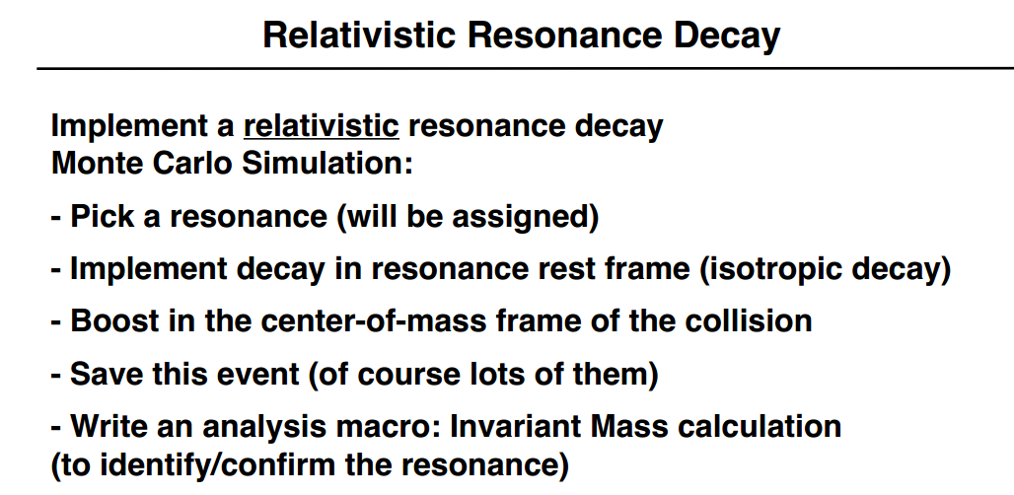
Problem:

Slide 3
What we need
Rho
TLorentz vector
Event class
Track class
Momentum
Tree

Slide 4
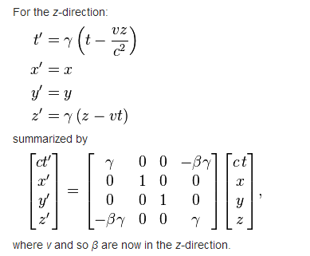
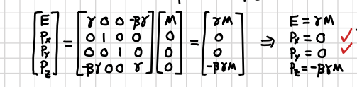
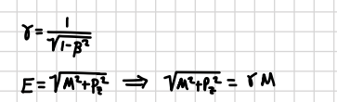
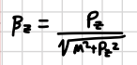

How to perform the Boost
Boost in the z direction
So, we can use the boost command available in TLorentz vector
http://en.wikipedia.org/wiki/Lorentz_transformation

Slide 5
Shared libraries
Event class
event.h
event.C
Track class
track.h
track.C

Slide 6
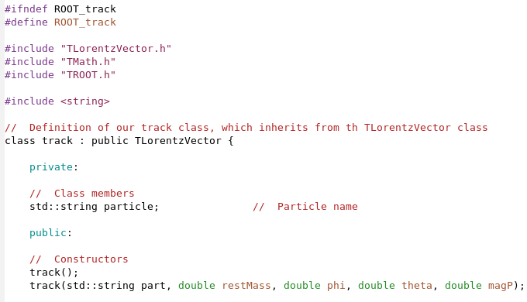
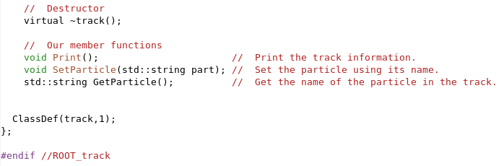
Track.h
Using the 4 vector: TLorentzVector
Constructor is defined using the
name of the partice
Rest mass
Phi : azimuthal angle
Theta: polar angle
Momentum

Slide 7
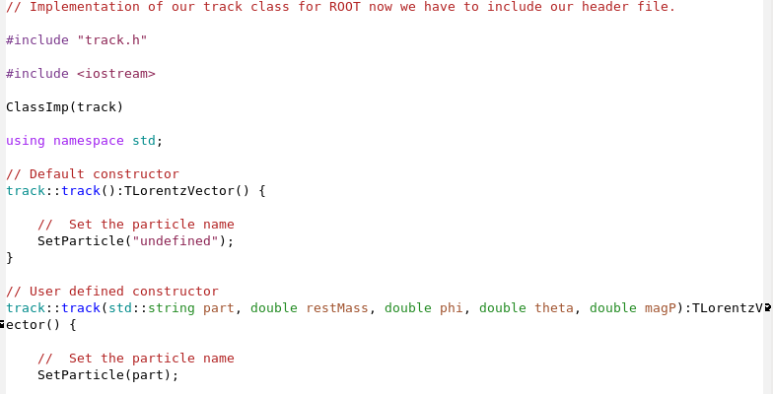
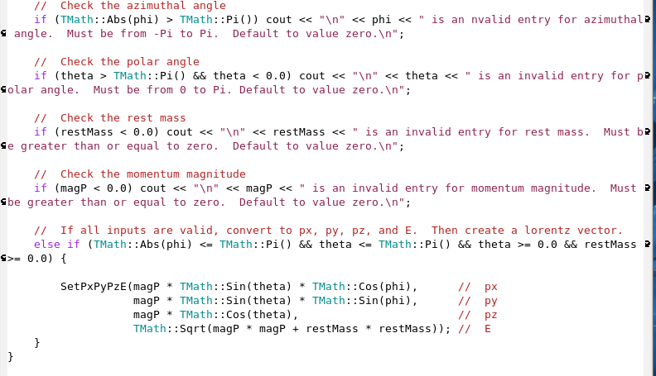
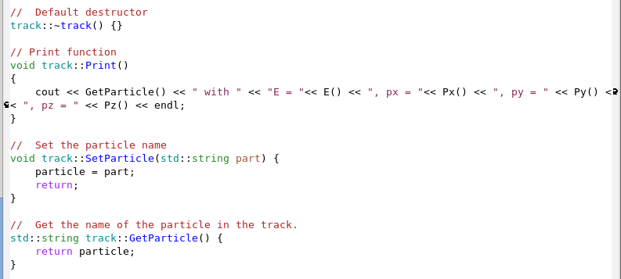
Track.C
constructor
Destructor
Setters
Getters

Slide 8
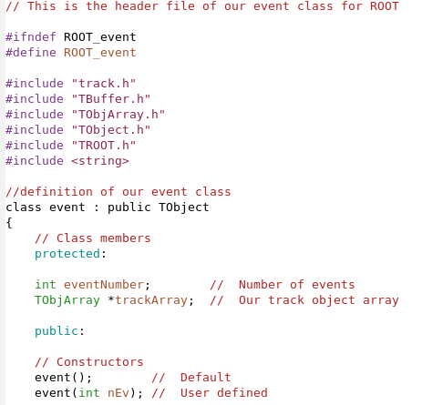
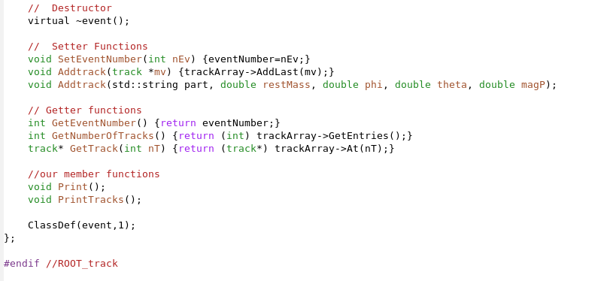
Event.h
Set the number of events and add tracks
Get the number of events, the number of tracks, and the track itself

Slide 9
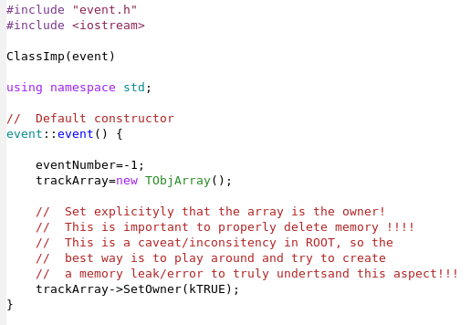
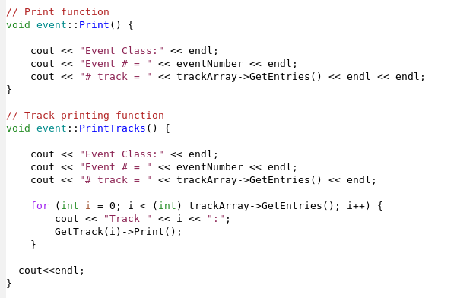
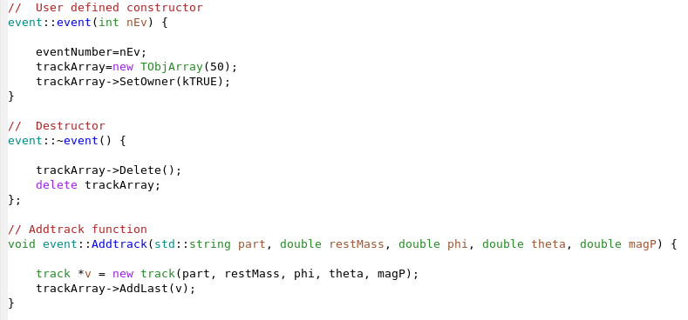
Event.C

Slide 10
Excecutable Macro
ResonanceDecay.C
AnalyseResonance.C
To create the events and decays
boost them
save in a tree
To read the results from the tree
Calculate the invariant mass
Repeat for all the saved events

Slide 11
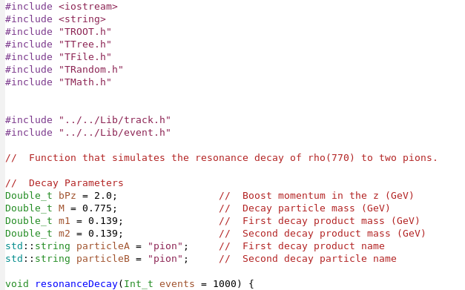
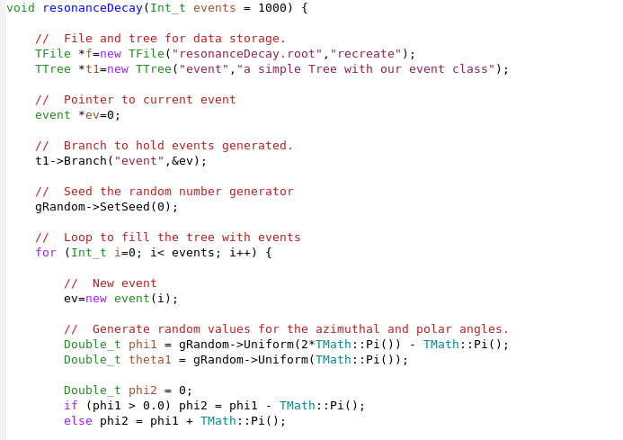
ResonanceDecay.C
Setting up the decay
user defined values:
mass of daughter particles
Mass of mother particle
Momentum of mother after boost in z direction
Names of daughter particles depending on the decay taking place
Setting up the tree and pointing the event to the created branch
Seed Random number generator to select the angle at which the daughter particles are decayed at

Slide 12
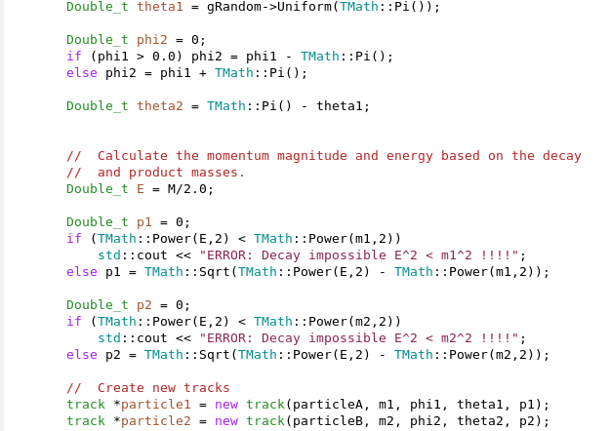

ResonanceDecay.C
z
y
pion
θ
Rho
φ
x
180+ φ
pion
180+θ
Each daughter particle starts with p=0 and receives half the mother energy
Evaluating the momentum of daughter particles and creating track to save their information within
$$p=\sqrt{E^{2}+m^{2}}$$

Slide 13
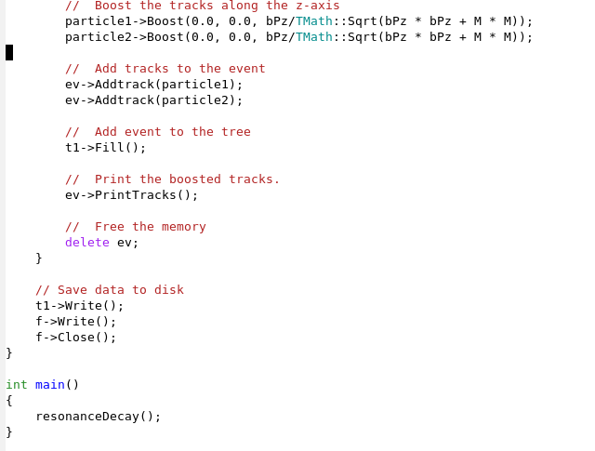
ResonanceDecay.C

Slide 14
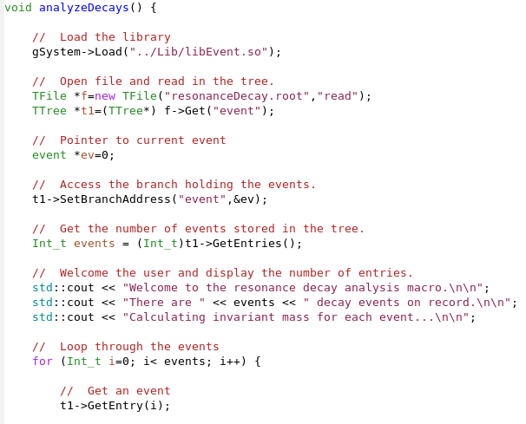
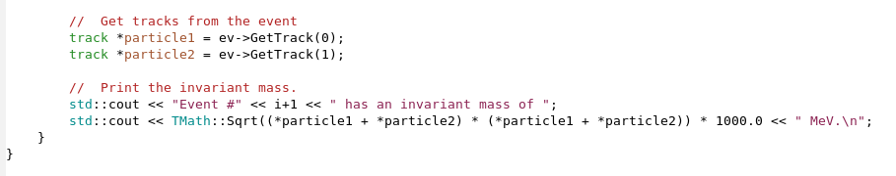
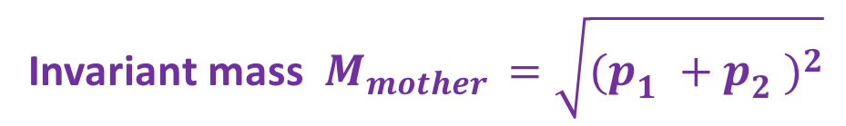
AnalyseDecay.C
Accessing Tree
Branch
Event
Entry (Tracks)
Calculate the invariant mass for each event
Invariant mass $M_{mother }=\sqrt{{(p_{1}^{}+p_{2}^{})}^{2}}$

Slide 15
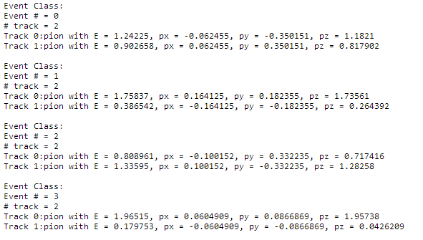
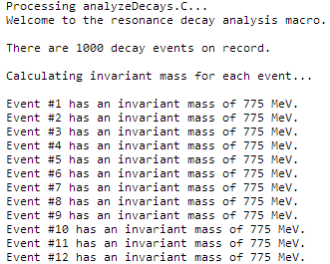
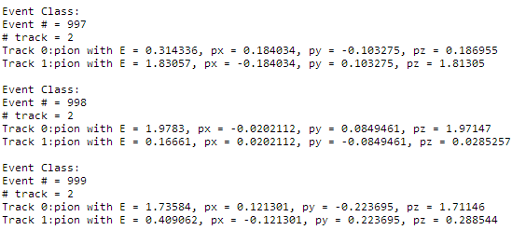
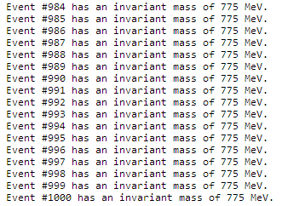
Final result
Evaluate the invariant mass for all stored events, and the same value of 775 MeV confirms that the program is running smoothly
Up to 1000 events

Slide 16
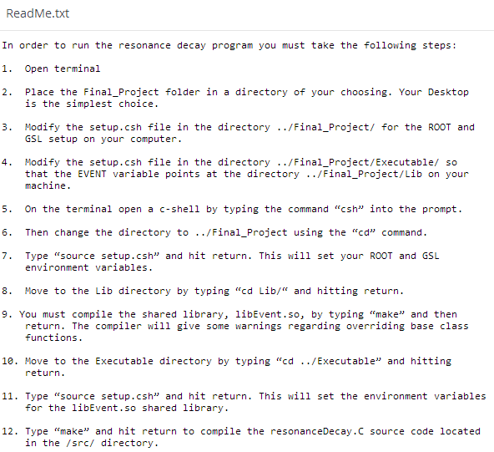
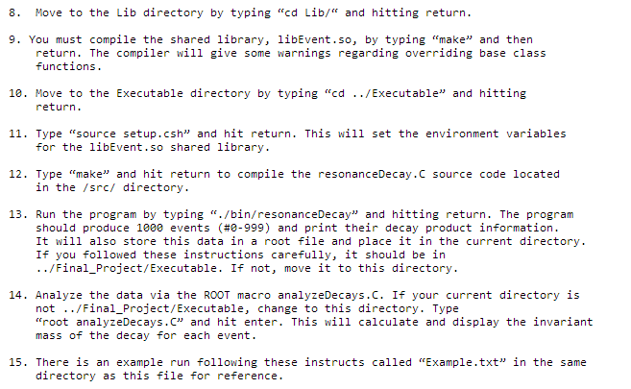
We have also included a Readme text file to help with setting out the environment and running the code

